Slide 1



Extract Data from Image
Biware solution
work produced by Daoud Aymen
work supervised by : Nadia Jmour PHD specialist in AI

Slide 2


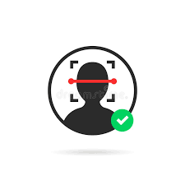


Recap
Liveness detection
Face matching
OCR
Voice identification and recognition
Stage ouvrier

Slide 3
What is Optical Character Recognition (OCR)?
OCR, or Optical Character Recognition, is a process of recognizing text inside images and converting it into an electronic form. These images could be of handwritten text, printed text like documents, receipts, name cards, etc., or even a natural scene photograph.
OCR has two parts to it. The first part is text detection where the textual part within the image is determined. This localization of text within the image is important for the second part of OCR, text recognition, where the text is extracted from the image. Using these techniques together is how you can extract text from any image.

Slide 4
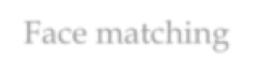
Extract Data from Image
Approach 1 Text Recognition with Tesseract OCR
Tesseract is an open-source OCR engine originally developed as proprietary software by HP (Hewlett-Packard)
Approach 2 Text Recognition with EasyOCR
The EasyOCR package is created and maintained by Jaided AI, a company that specializes in Optical Character Recognition services.
Approach 3 Text Recognition with PaddleOCR (deep learning package )
For each approach we work on 3 different card ID (eng – fr – ara)

Slide 5
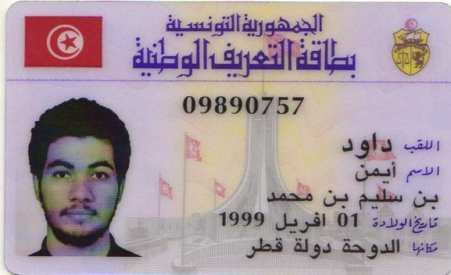
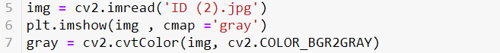
Extract Data from Image
Install libraries
import cv2
import numpy as np
import pytesseract
import matplotlib.pyplot as plt
import pandas as pd
from PIL import Image
Display Image and convert it to gray

Slide 6
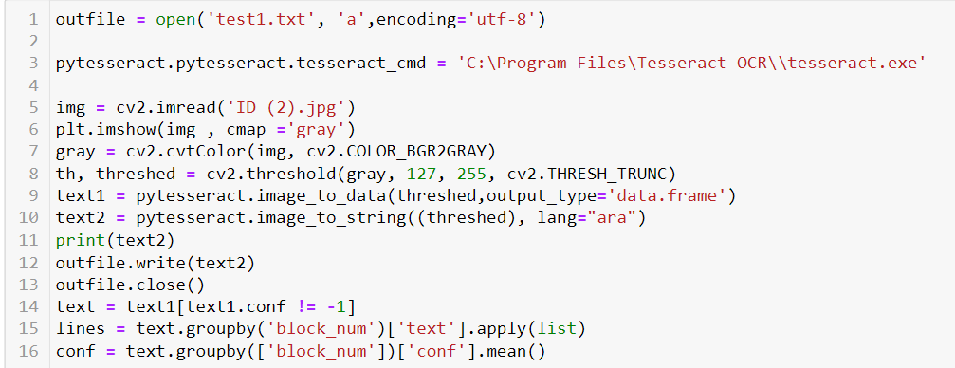
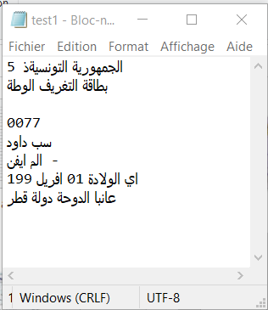
Extract Data from Image
Extracting Data and register the result in File.txt

Slide 7
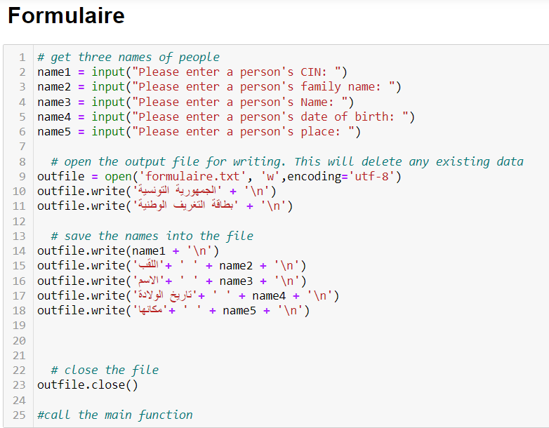
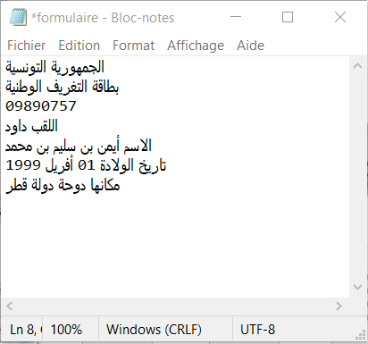
Extract Data from Image
Fill in the Form (Tunisian ID card)

Slide 8
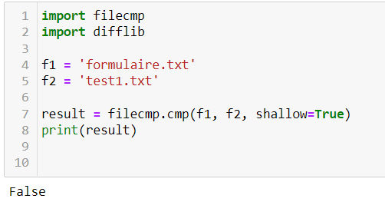
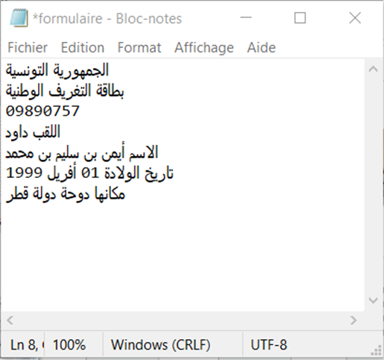
Extract Data from Image
Compare the 2 files

Slide 9
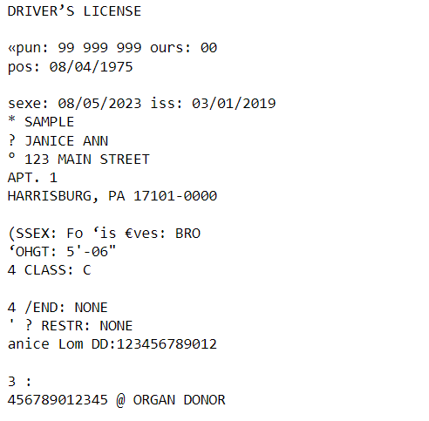
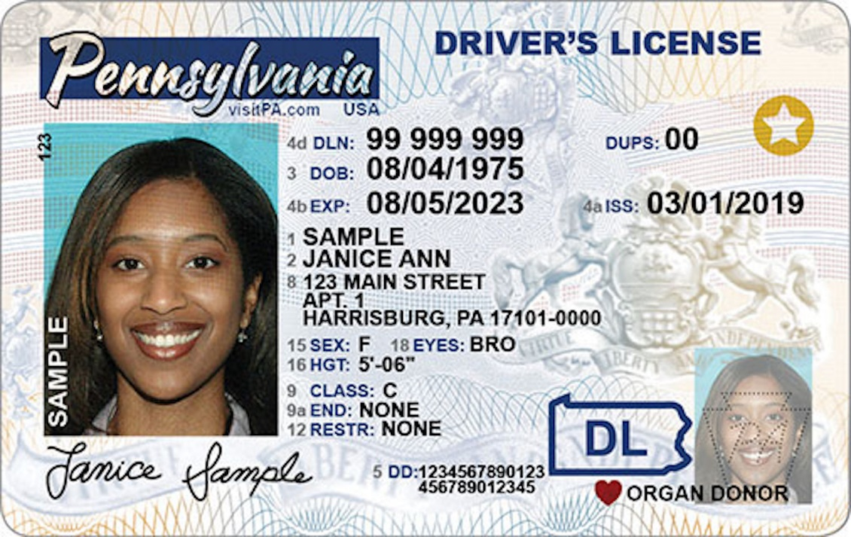
Extract Data from Image
We do the same approach for english ID and french ID

Slide 10
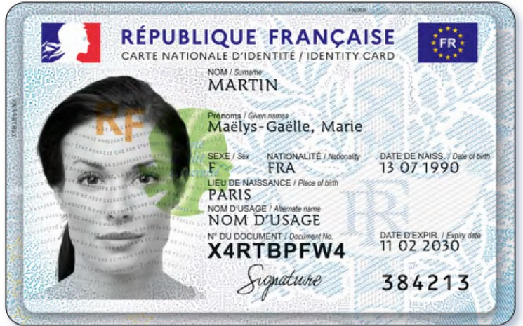
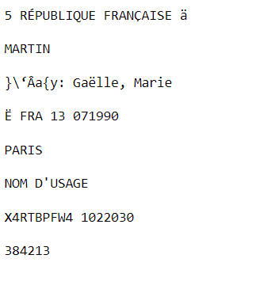
Extract Data from Image
We do the same approach for english ID and french ID

Slide 11

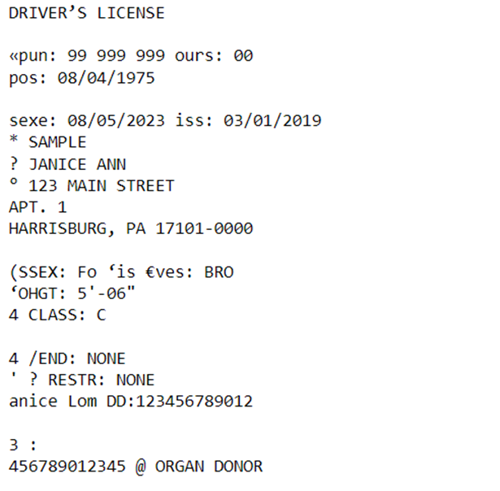
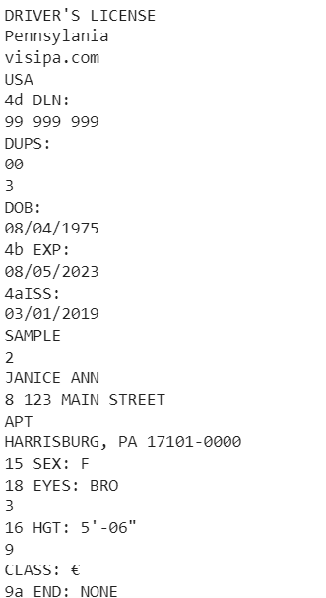
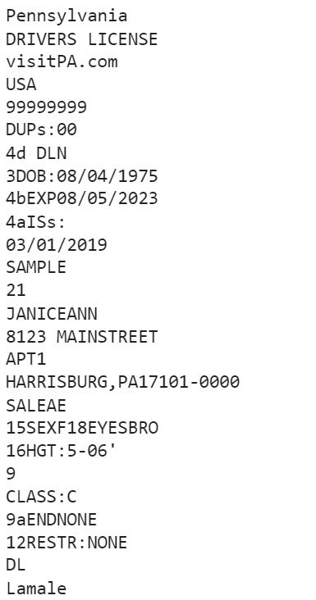
Extract Data from Image
Compare the results
Pytesseract
PaddleOCR
EasyOCR

Slide 12

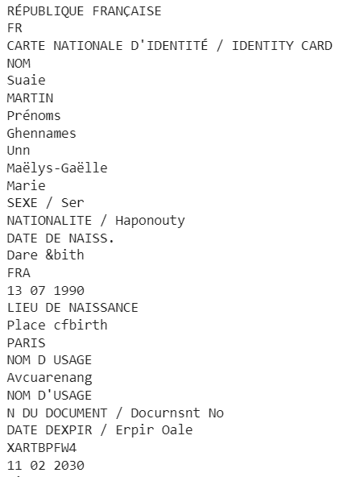
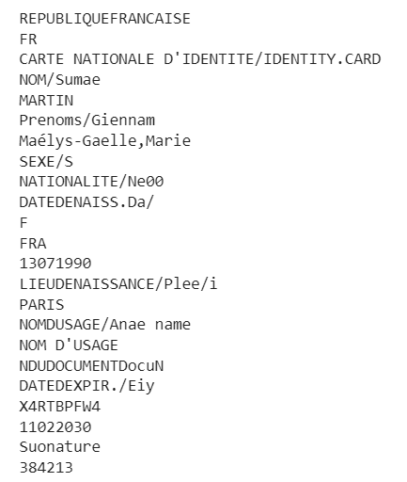
Extract Data from Image
Compare the results
Pytesseract
PaddleOCR
EasyOCR

Slide 13

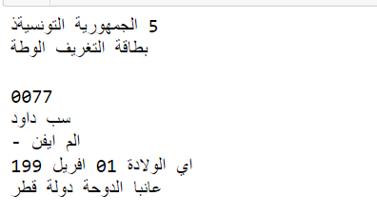
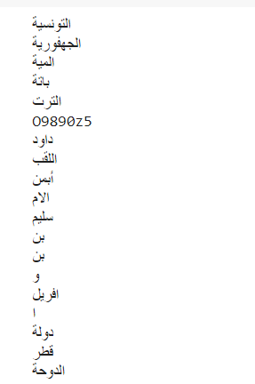
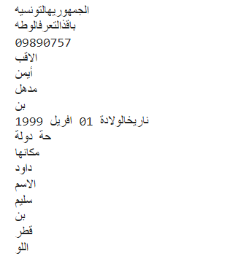
Extract Data from Image
Compare the results
Pytesseract
PaddleOCR
EasyOCR

Slide 14
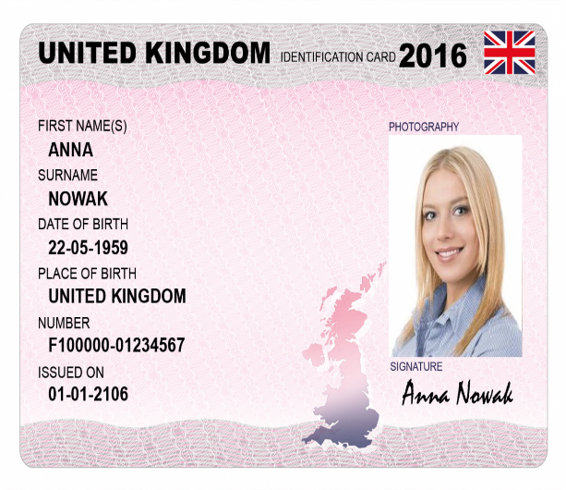
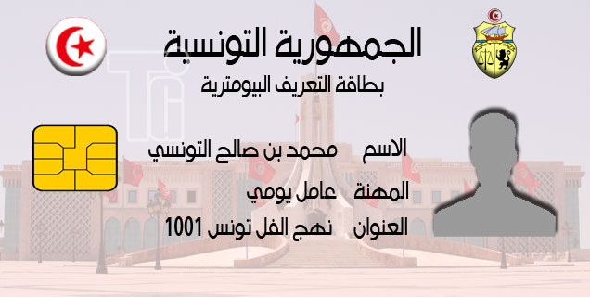
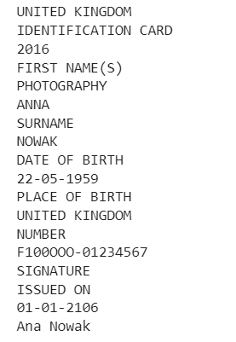
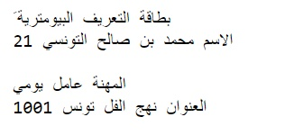
Extract Data from Image
Examples with 100% Accuracy

Slide 15
Conclusion
How we can expalin the errors
Different Language in one image
Blurry image
Using special style or small size for caracters
PaddleOCR give the best result especially in english and french ID-Card
Solution
Improve the deep learning structure
Use MicroAzure cognitive services for OCR

Slide 16
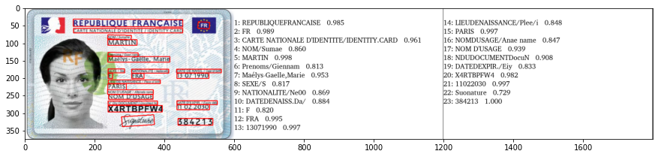
Conclusion
PaddleOCR also offers different models based on size.
Lightweight models – Models which take less memory and are faster but compromise on accuracy.
Server models (Heavyweight) – Models which take more memory but are more accurate but compromise on speed
.
PaddleOCR supports more than 80 languages (depending upon the OCR algorithm used)

